Slide 1

Computer Science Programming Network
Hosted by:
Saurabh Goyal Gideon Victor Sungbae Lee Johnseth Chong

Slide 2




Game Summary
Columbus Blue Jackets vs Los Angeles Kings
December 20, 2019
Tools for Analysis
Our Code
Our Visualizations & Website
Recap

Slide 3


NHL’s Undocumented API
https://statsapi.web.nhl.com/api/v1/game/2019020541/feed/live
Flask
Web framework to build web application
HTML/CSS
Create website and stylize it
JavaScript
Create interactive charts to display data
MongoDB
Used to store our data from NHL json data
jQuery/Tooltip/Plotly
To create an interactive web page to display our data visualizations

Slide 4

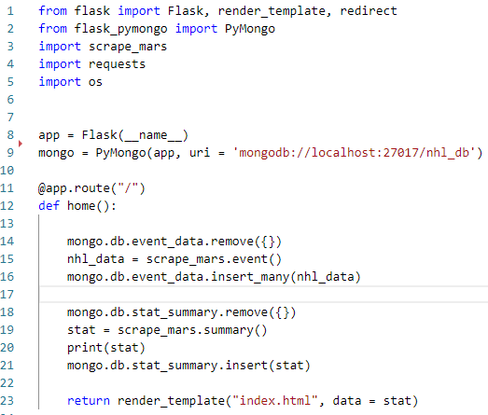
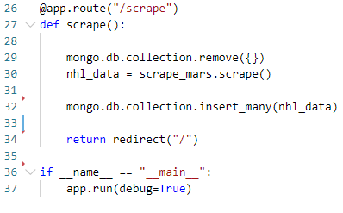

Slide 5
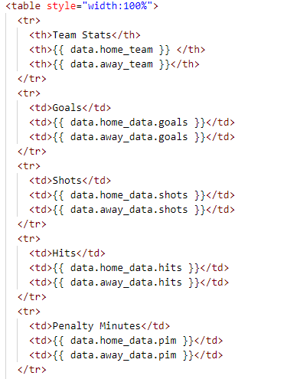
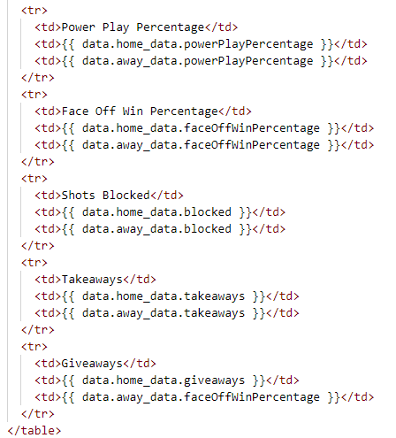

Slide 6

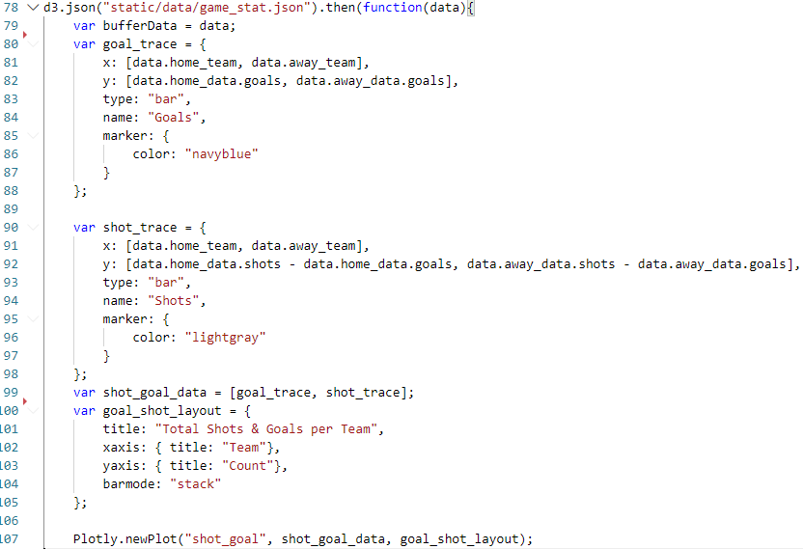

Slide 7
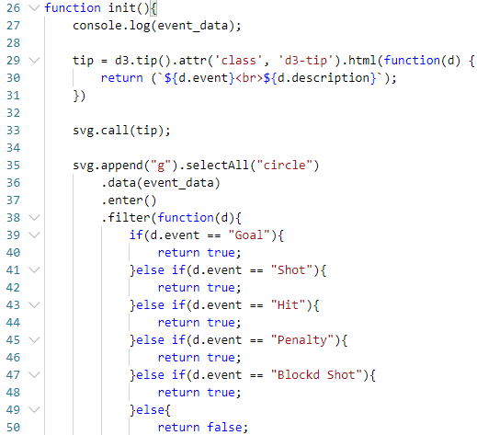
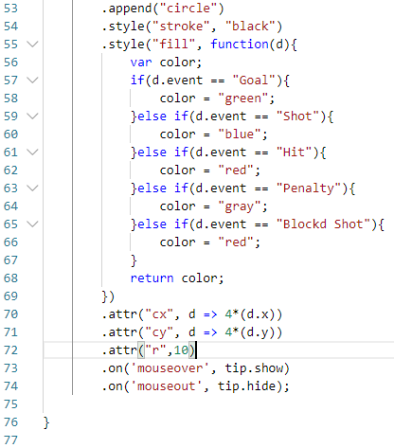

Slide 8




Slide 9

Columbus Blue Jackets defeated LA Kings 3-2 in Overtime
Key Factors for Blue Jackets Victory
More shots, more opportunities to score
Blue Jackets outshot the Kings 28-25
Winning majority of the faceoffs 40-30 (57.1% to 42.9%)
Win the possession battle
Blue Jackets had more takeaways (10-6) and less giveaways (6-7)
Key Factors for Kings Loss
Too many penalty kill
Kings doubled the Blue Jackets’ penalties and penalty minutes, 4-2 & 8 min - 4 min, respectively
This created four Power Play Opportunities for the Blue Jackets, where they scored one Power Play Goal
Out-hitting the Blue Jackets 25-18
Kings spent more time on defense than offense

